Slide 1


Why SmartMusic?

Slide 2
SmartMusic is a browser-based music education platform that connects teachers and students.
It facilitates focused practice, assessment and immediate feedback, making the link between educator and student even more powerful.
© 2017 Peaksware. All rights reserved.

Slide 3
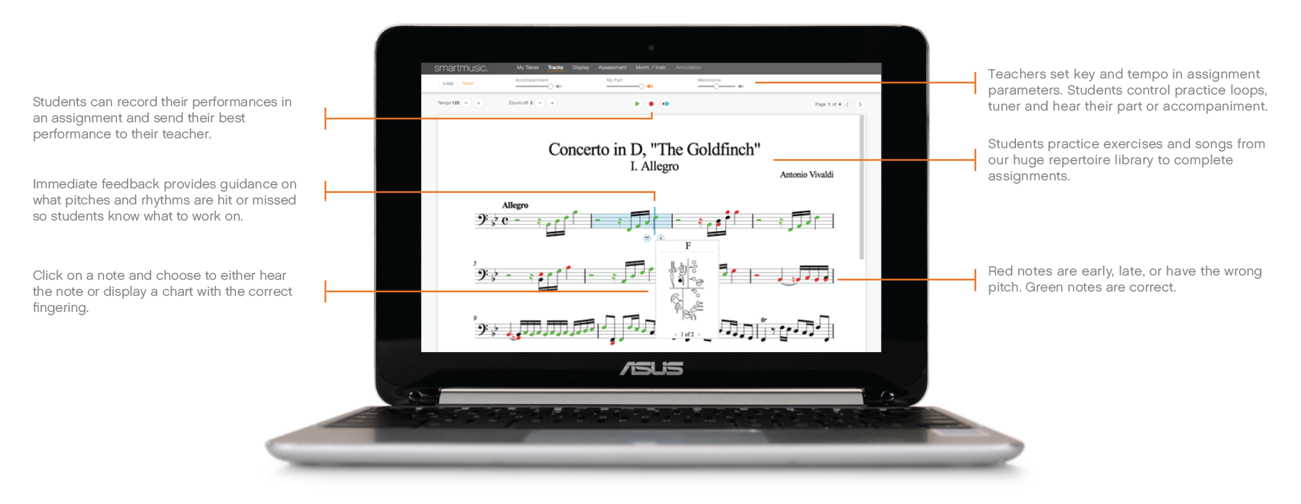
Flip the Classroom
© 2017 Peaksware. All rights reserved.

Slide 4

Immediate Feedback
Like a tutor with infinite patience
Immediately shows students what pitches and rhythms they hit or miss
Students know what to work on to get the best grade
© 2017 Peaksware. All rights reserved.

Slide 5

Guided Practice
Differentiate assignments in many ways
Much like a math or english teacher can assess individual student learning with a worksheet assignment, SmartMusic helps music teachers use home practice data to focus on individualized student needs and guide future instruction.
Creates a portfolio of student work and progress
© 2017 Peaksware. All rights reserved.

Slide 6

Repertoire
SmartMusic includes thousands of pieces for band, orchestra and choir, which can be assigned, including:
Method books
Ensemble titles
Solos
Practice exercises & scales
Sight-reading materials
Predefined assignments
PLUS, the ability to import self-created compositions (from any music notation software)
© 2017 Peaksware. All rights reserved.

Slide 7
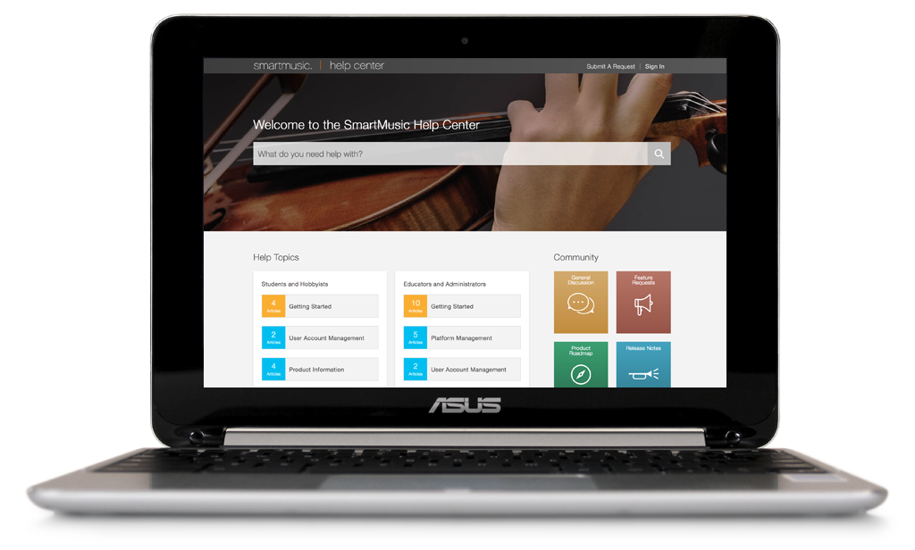
Tech Support
Includes Help Center support
No need for technology department to intervene; web-based platform means updates are done automatically
Export the SmartMusic Gradebook for use in any LMS
Compatible with devices students use, including Chromebooks, desktops, laptops, and iPads
© 2017 Peaksware. All rights reserved.

Slide 8
SmartMusic Gets Results
Transforms practice from passive repetition to active learning
Students experience faster progress
Motivating and fun to use
No more guessing – immediate feedback
Differentiated assignments & grading scales
Grades are based on skill achievement, not just practice minutes
© 2017 Peaksware. All rights reserved.

Slide 9
SmartMusic Subscription Structure
TEACH subscription = platform for the organization that includes all the tools teachers need to:
Create classes
Enroll students
Send assignments
Utilize gradebook functionality
TEACH Seats - refers to teacher access; ability to access ALL content from the SmartMusic library
PLAY Seats - refers to student assignment only access; can play only music assigned by their teacher
PLAY Plus seats - refers to student ALL access to content, even that which is not assigned by their teacher; gives student ability to explore on their own
© 2017 Peaksware. All rights reserved.

Slide 10
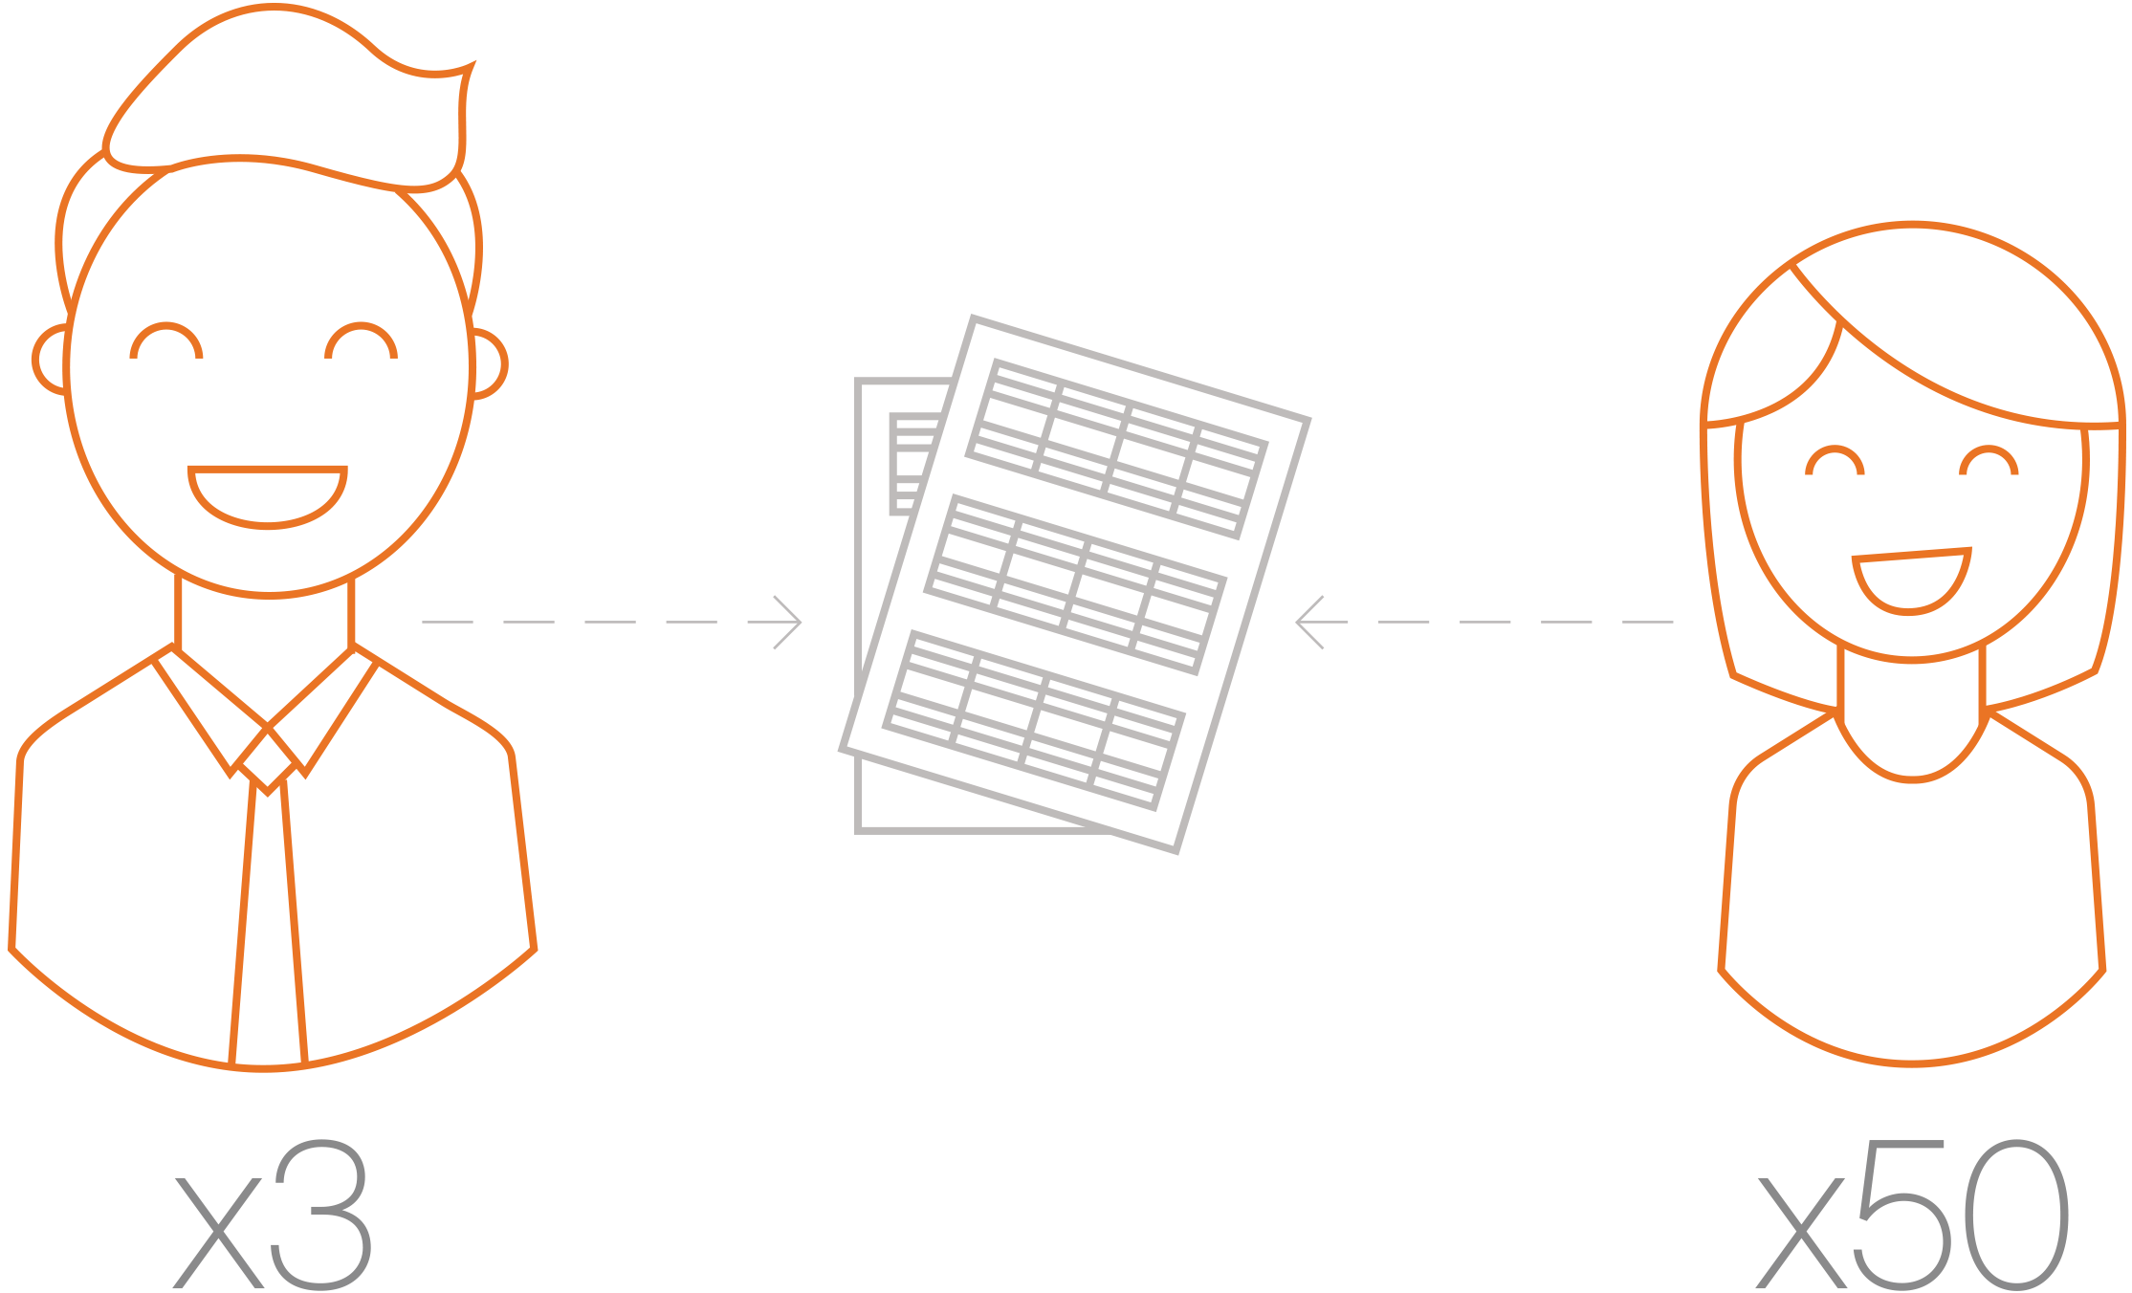
Priced to Fit Any Class Size
SmartMusic TEACH subscription starts at $399/year which includes:
Up to 3 educator TEACH seats
Up to 50 student PLAY seats
Add TEACH seats for $40/year
Add student PLAY seats for $40/year (in blocks of 5)
Transferable to new students
More blocks can be added at any time
Add enhanced student access to content with PLAY Plus seats
School purchased = $20/student per year
Individual purchased = $40/student per year
© 2017 Peaksware. All rights reserved.

Slide 11
Program Size: 125 Enrolled Students
Class Name | Class Size | Total by School | Grand Total
6th Grade Orchestra | 35 | 82 | 125
7/8th Grade Orchestra | 47
High School Orchestra | 30 | 43
High School Honors Orchestra | 13
© 2017 Peaksware. All rights reserved.

Slide 12
Pricing Example: Cost for 125 students
Quantity | Description | Rate | Amount
1 | Paid access to the SmartMusic TEACH platform; price includes 3 teacher seats and 50 student seats | $399.00 | $399.00
15 | Adding blocks of 5 student seats to a TEACH platform | $40.00 | $600.00
43 | Adding PLAY Plus access for HS Orchestra and HS Honors Orchestra | $20.00 | $860.00
Annual Cost |  |  | $1,859.00
© 2017 Peaksware. All rights reserved.

Slide 13
Perfect Time to Adopt
Facilitates full classroom coverage
Customized levels of student access, starting at $7.99/student
Fosters individualized instruction
Boosts student achievement and increased engagement
Works on more devices including computers, iPads and now Chromebooks!
© 2017 Peaksware. All rights reserved.

Slide 14
Thank you for your consideration!

