Slide 1
Garritan Abbey Road Studios CFX Concert Grand
Add rich piano playback to your DAW or music notation software with this powerful piano
sound library.

Slide 2
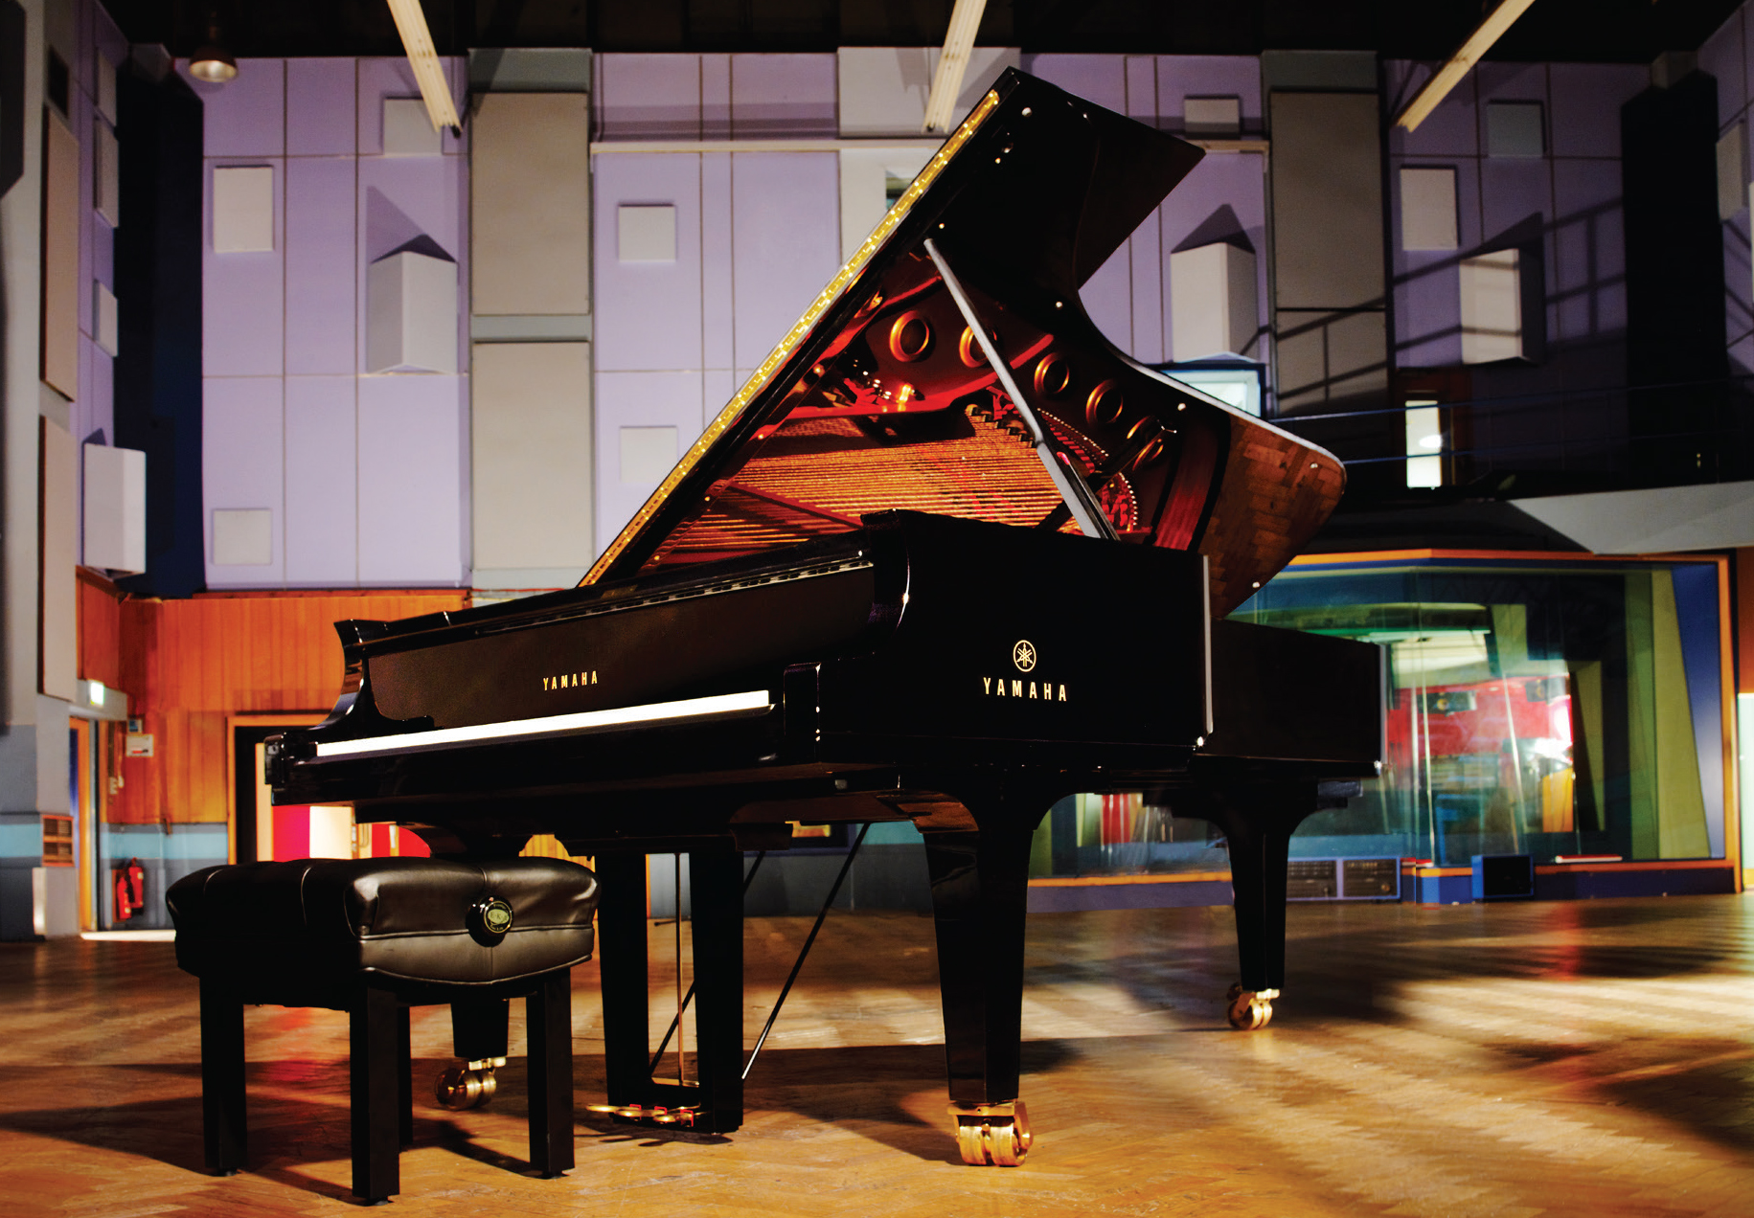
GARRITAN ABBEY ROAD STUDIOS CFX CONCERT GRAND
The Garritan Abbey Road Studios CFX Concert Grand places you on the bench before a remarkable concert grand piano that is characterized by a wide palette of tonal colors and an ability to create the most subtle, expressive nuances.
This beautiful instrument is matched with the stunning acoustics of Abbey Road Studios’ historic Studio One and the finest collection of microphones in the world.
Garritan has combined these ingredients to create the finest sampled piano ever captured, offering a wealth of creative possibilities.

Slide 3
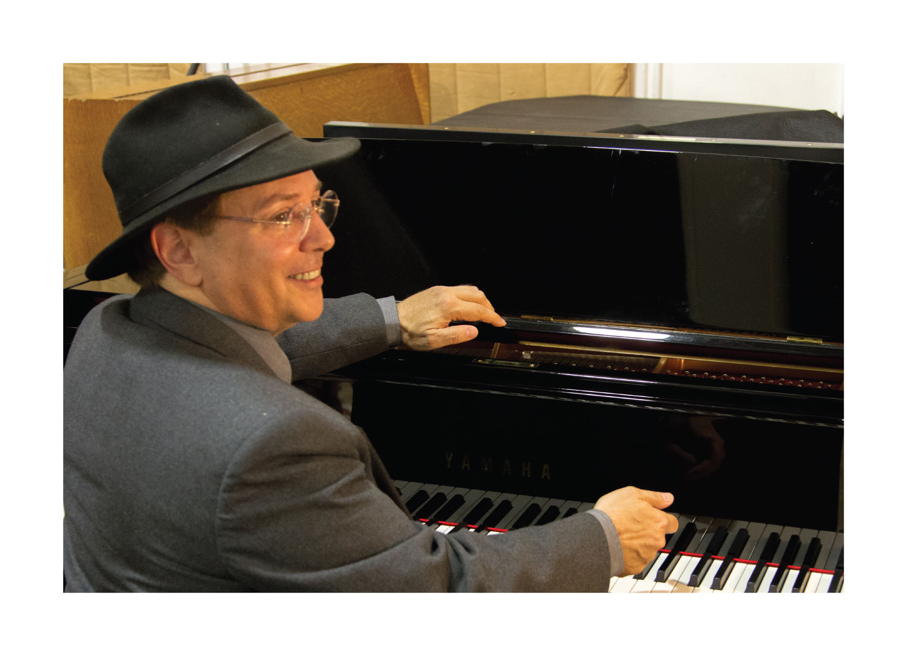
GARRITAN
Garritan’s dedication to accessibility and excellence is epitomized in the CFX Concert Grand library.
Without this new virtual instrument, few would have access to Yamaha’s phenomenal CFX concert grand piano, let alone the opportunity to record in Abbey Road Studios’ historic Studio One with the greatest technicians and recording equipment in the world.

Slide 4
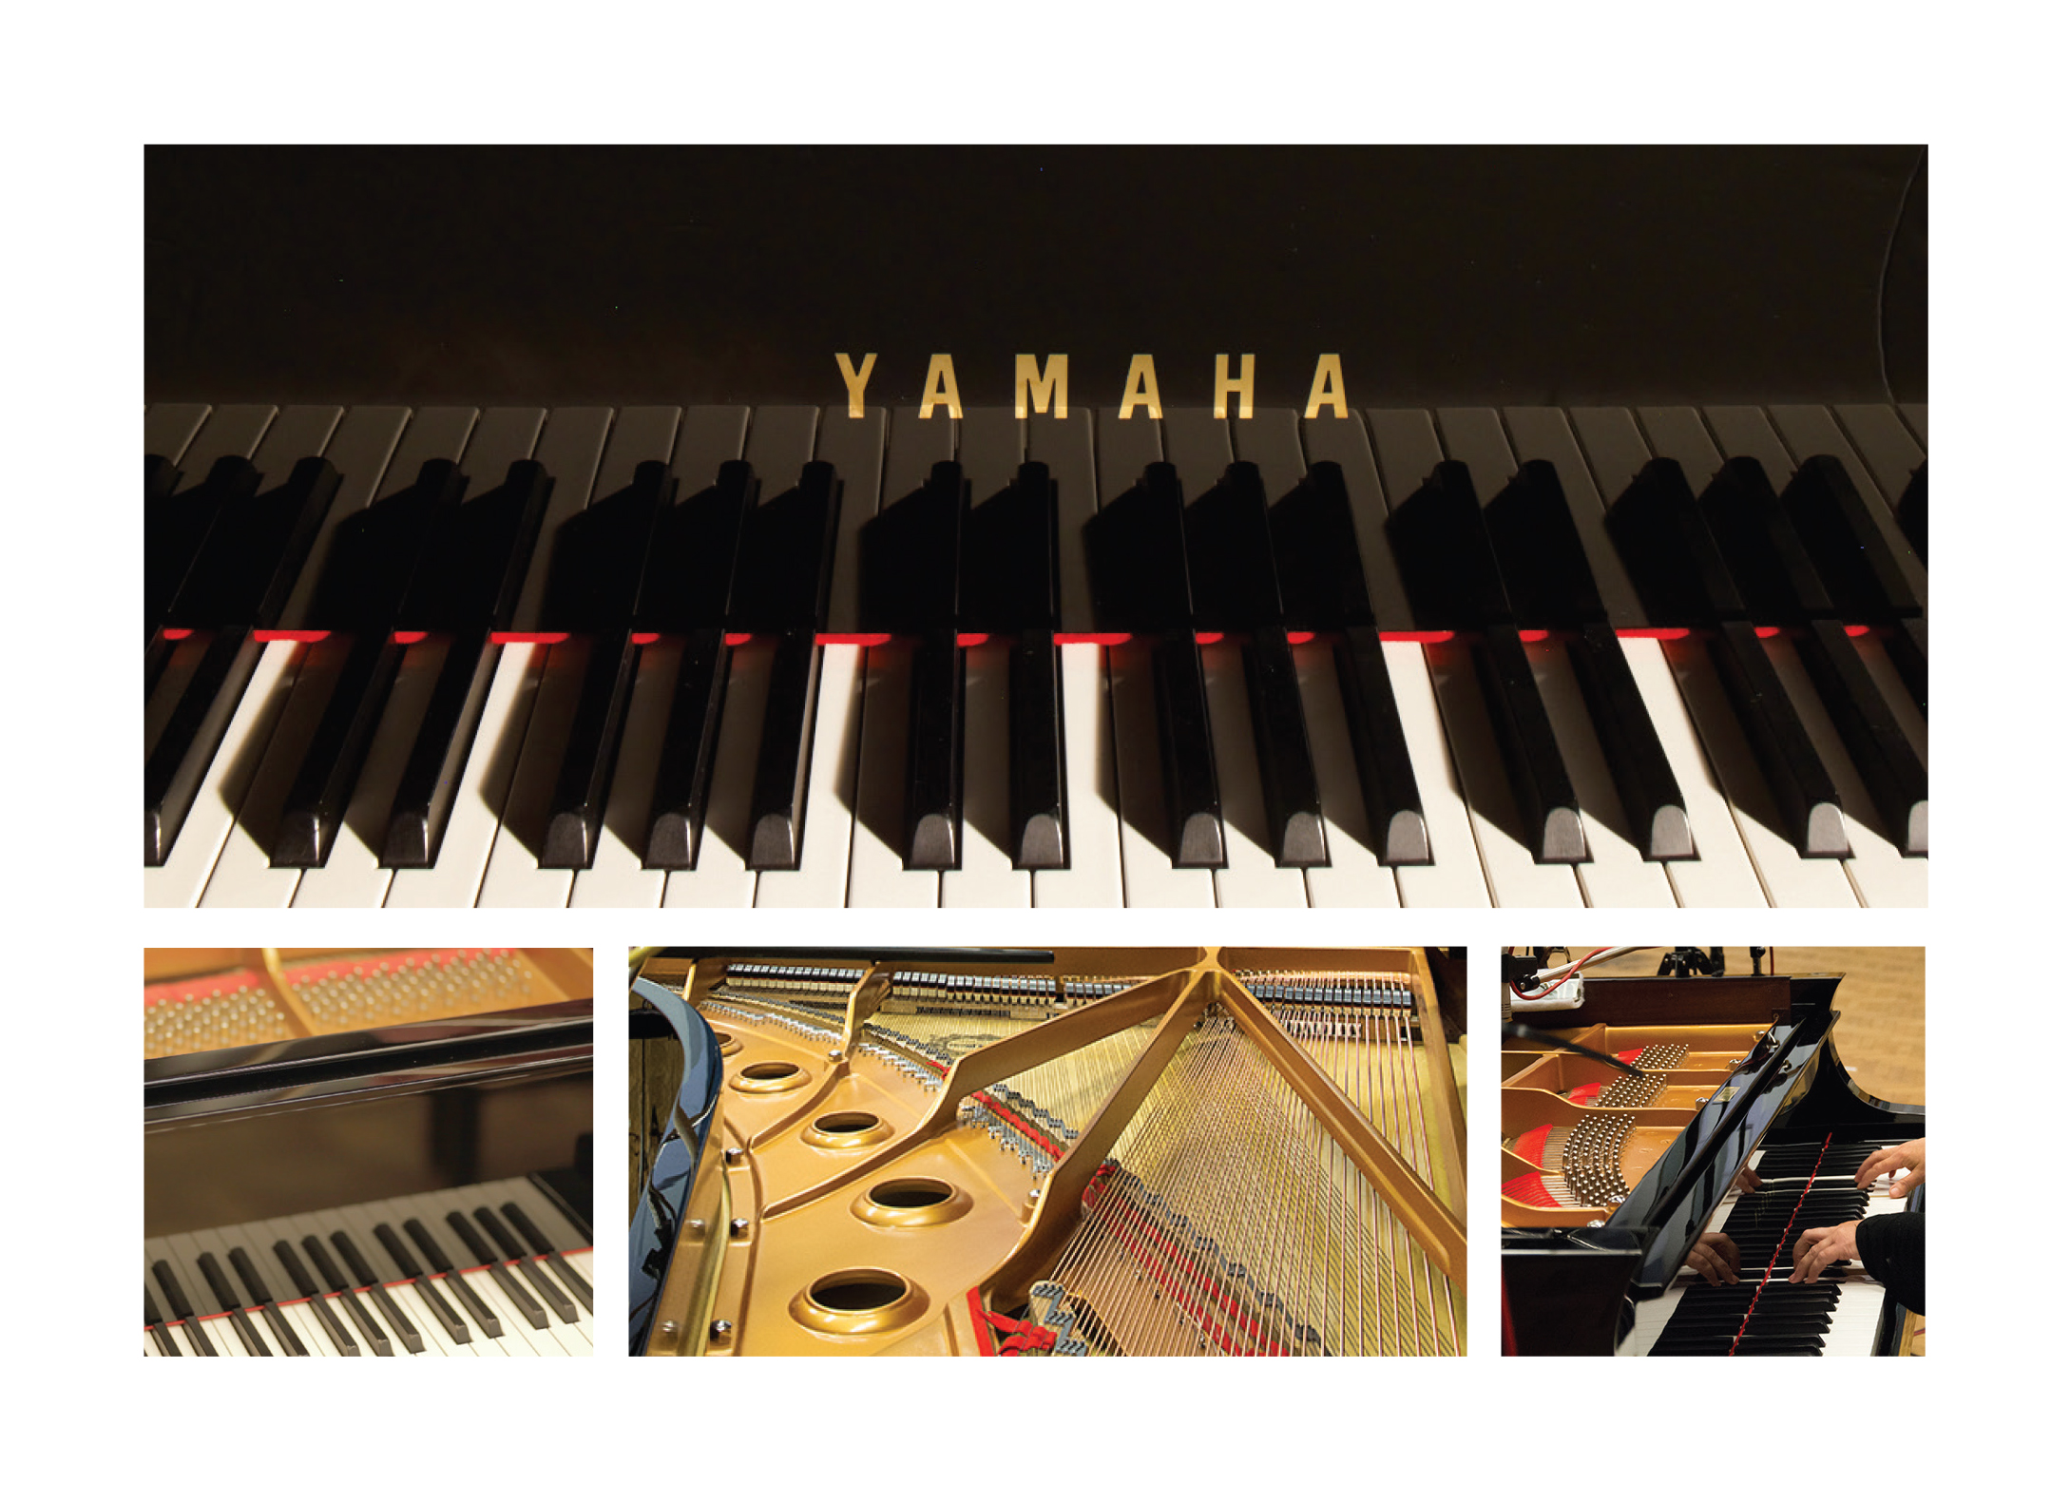
YAMAHA CFX CONCERT GRAND PIANO
In 1991, Yamaha began its most ambitious piano project ever: to create a new generation of grand piano for concert, conservatoire and studio performance. What followed was nearly 20 years of development and evaluation.
A 40-strong team of the world’s most talented piano designers, technicians, craftsmen and pianists deconstructed the concert grand and began rebuilding it from the ground up. Every aspect of traditional piano design was questioned, evaluated, improved, and relentlessly tested at concert halls across the globe.
The result was the CFX Concert Grand Piano, a revolutionary instrument.

Slide 5
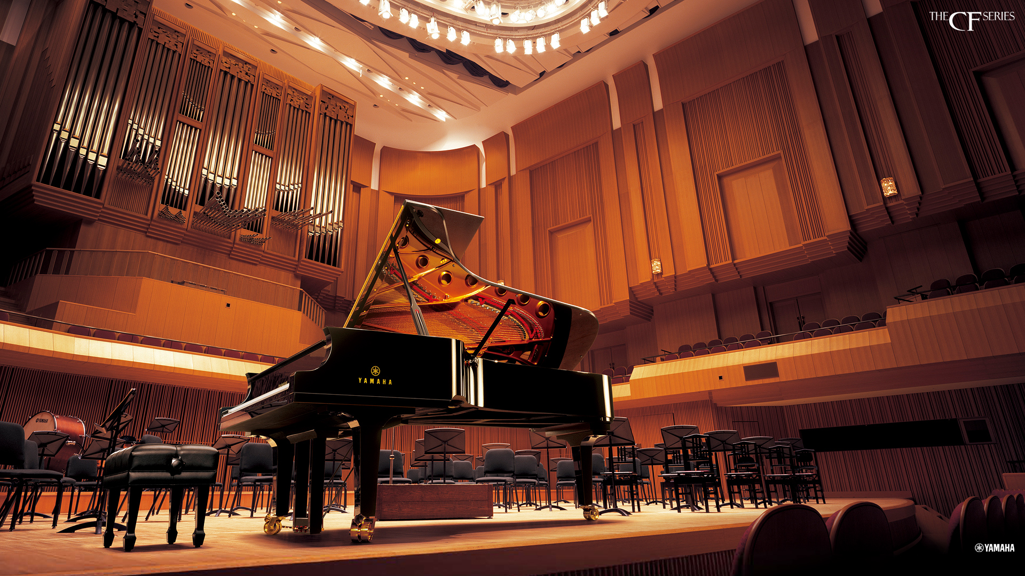
YAMAHA CFX CONCERT GRAND PIANO
Each CFX is entirely hand-built by a small team of the world’s most experienced and skilled craftsmen. All materials are meticulously selected and refined to ensure unprecedented music performance in the most demanding of situations. With enough tonal presence to be heard over the sound of a full symphony orchestra in the largest of concert halls, the CFX is truly one of the greatest pianos ever created.

Slide 6
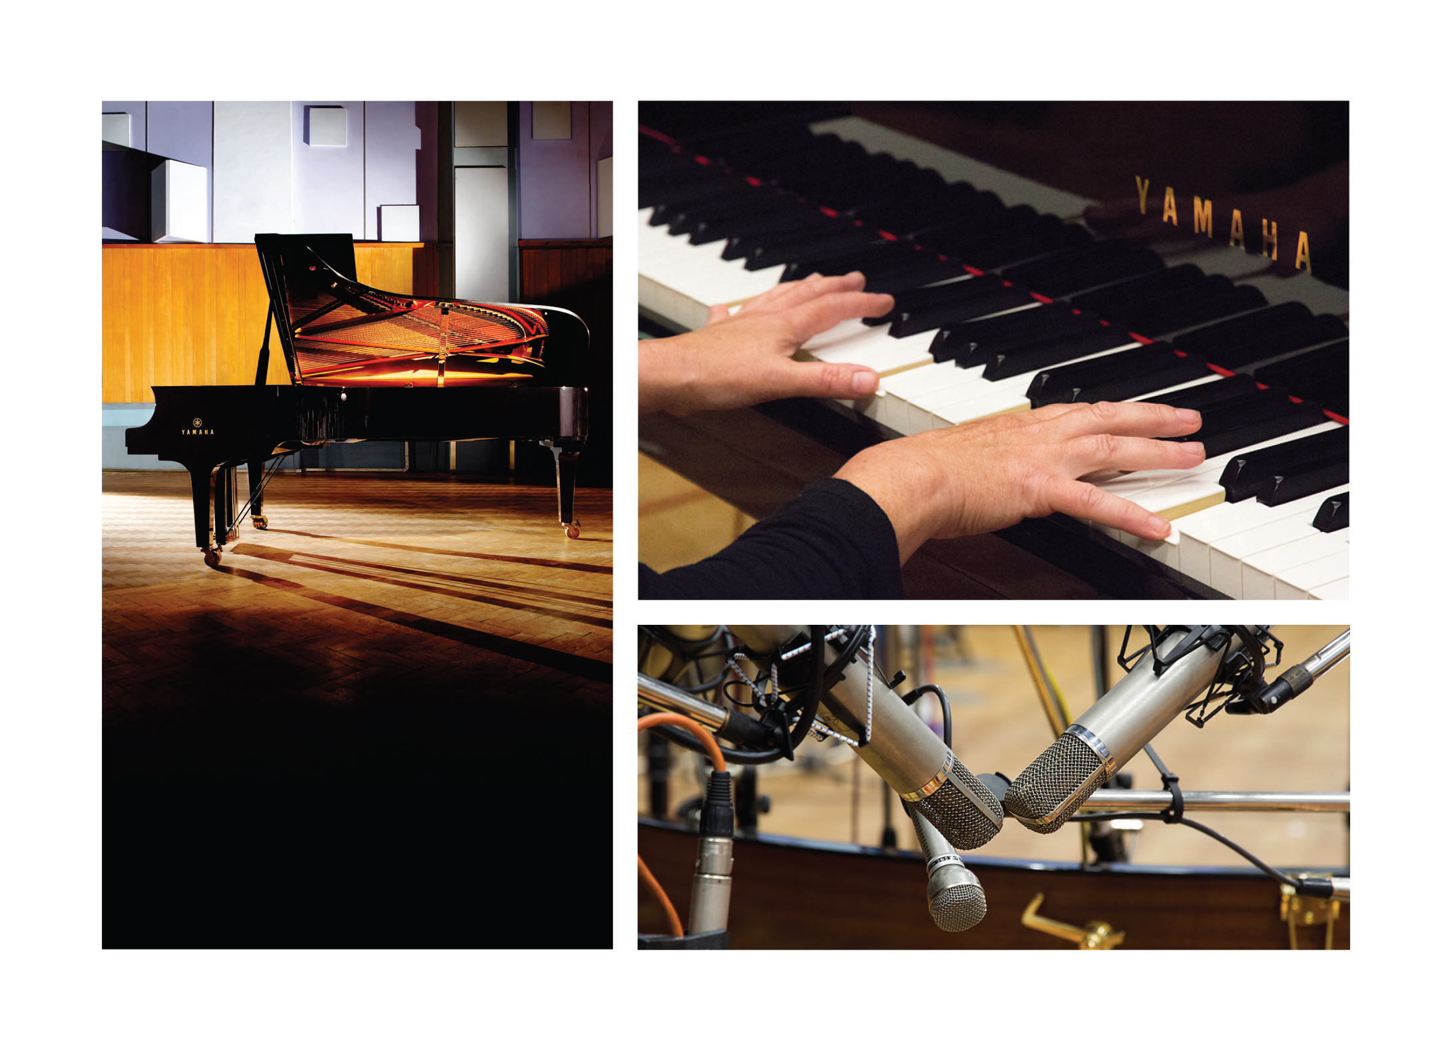
ABBEY ROAD STUDIOS
Even casual music fans know of London’s iconic Abbey Road Studios. Their acclaimed acoustics, engineers, and equipment have played a vital role in countless legendary recordings, from the Beatles, U2 and Pink Floyd, to blockbuster films, celebrated classical performers, and beyond. Musicians from around the world turn to Abbey Road Studios when they require the very best. The Abbey Road Studios engineers masterfully blend the latest technology with legendary equipment and acoustics. This “best of both worlds” approach also drove the design of the remarkable Yamaha CFX Concert Grand Piano.

Slide 7
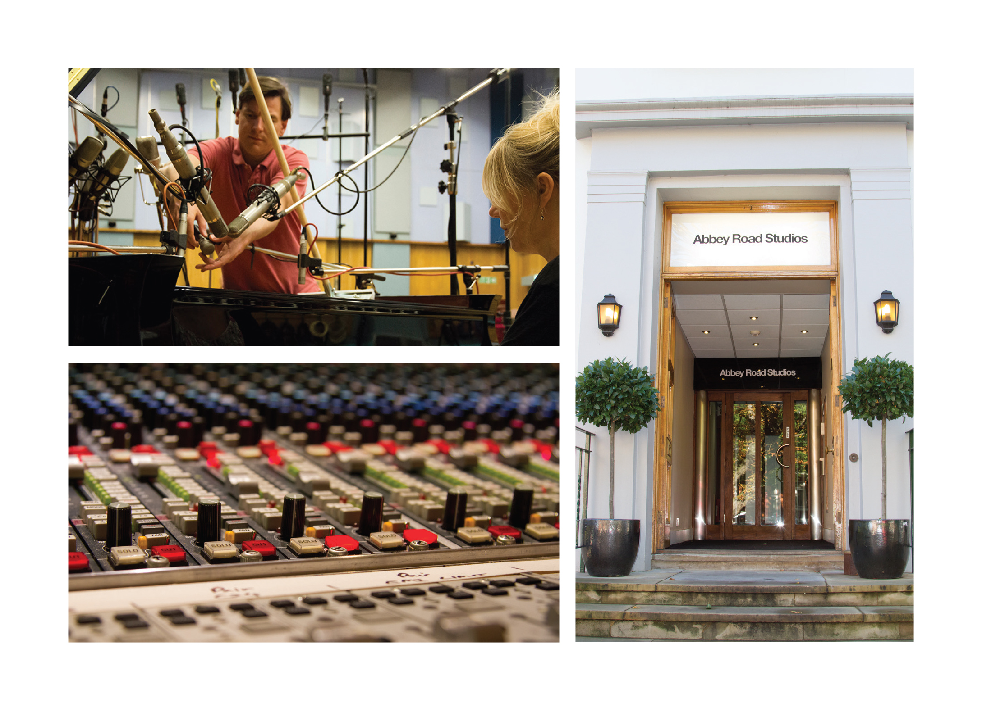
ABBEY ROAD STUDIOS
The Yamaha CFX piano was recorded at Abbey Road Studios, the world’s first purpose-built recording studios.
Abbey Road Studios’ Studio One is one of the largest and most beautiful sounding orchestral studios in the world. Studio One’s acoustic is as famous as its location, making it perfect for numerous types of recording, from solo piano to large orchestras.

Slide 8
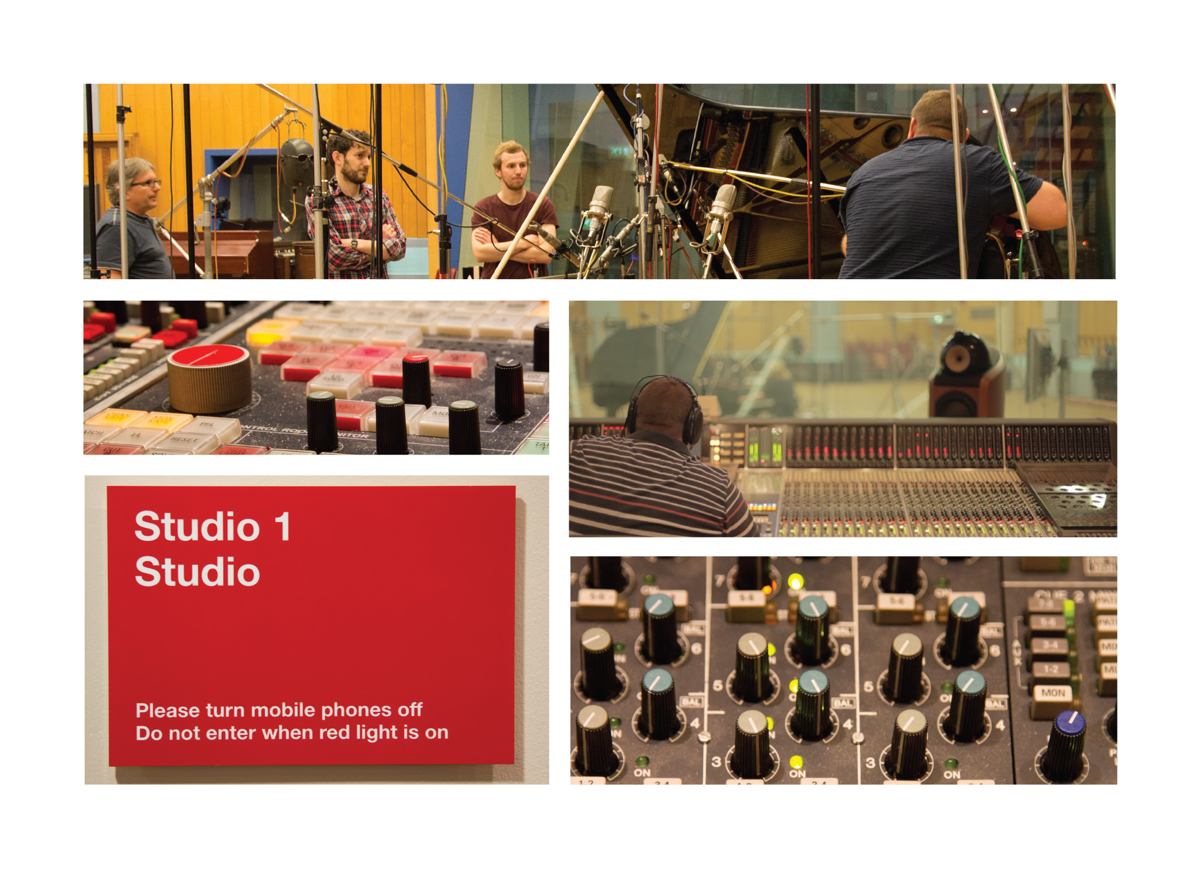
ABBEY ROAD STUDIOS
Originally designed to capture live performances, Studio One remains the world’s largest purpose-built recording facility. Its current incarnation was built in the spring of 2001 and houses a 72-channel Neve 88 RS console.
When Studio One opened, it was used exclusively by EMI’s prestigious His Master’s Voice (HMV) label and it continues to host classical recordings to this day. The room is now also used to record live concerts and scores to some of Hollywood’s biggest films.

Slide 9
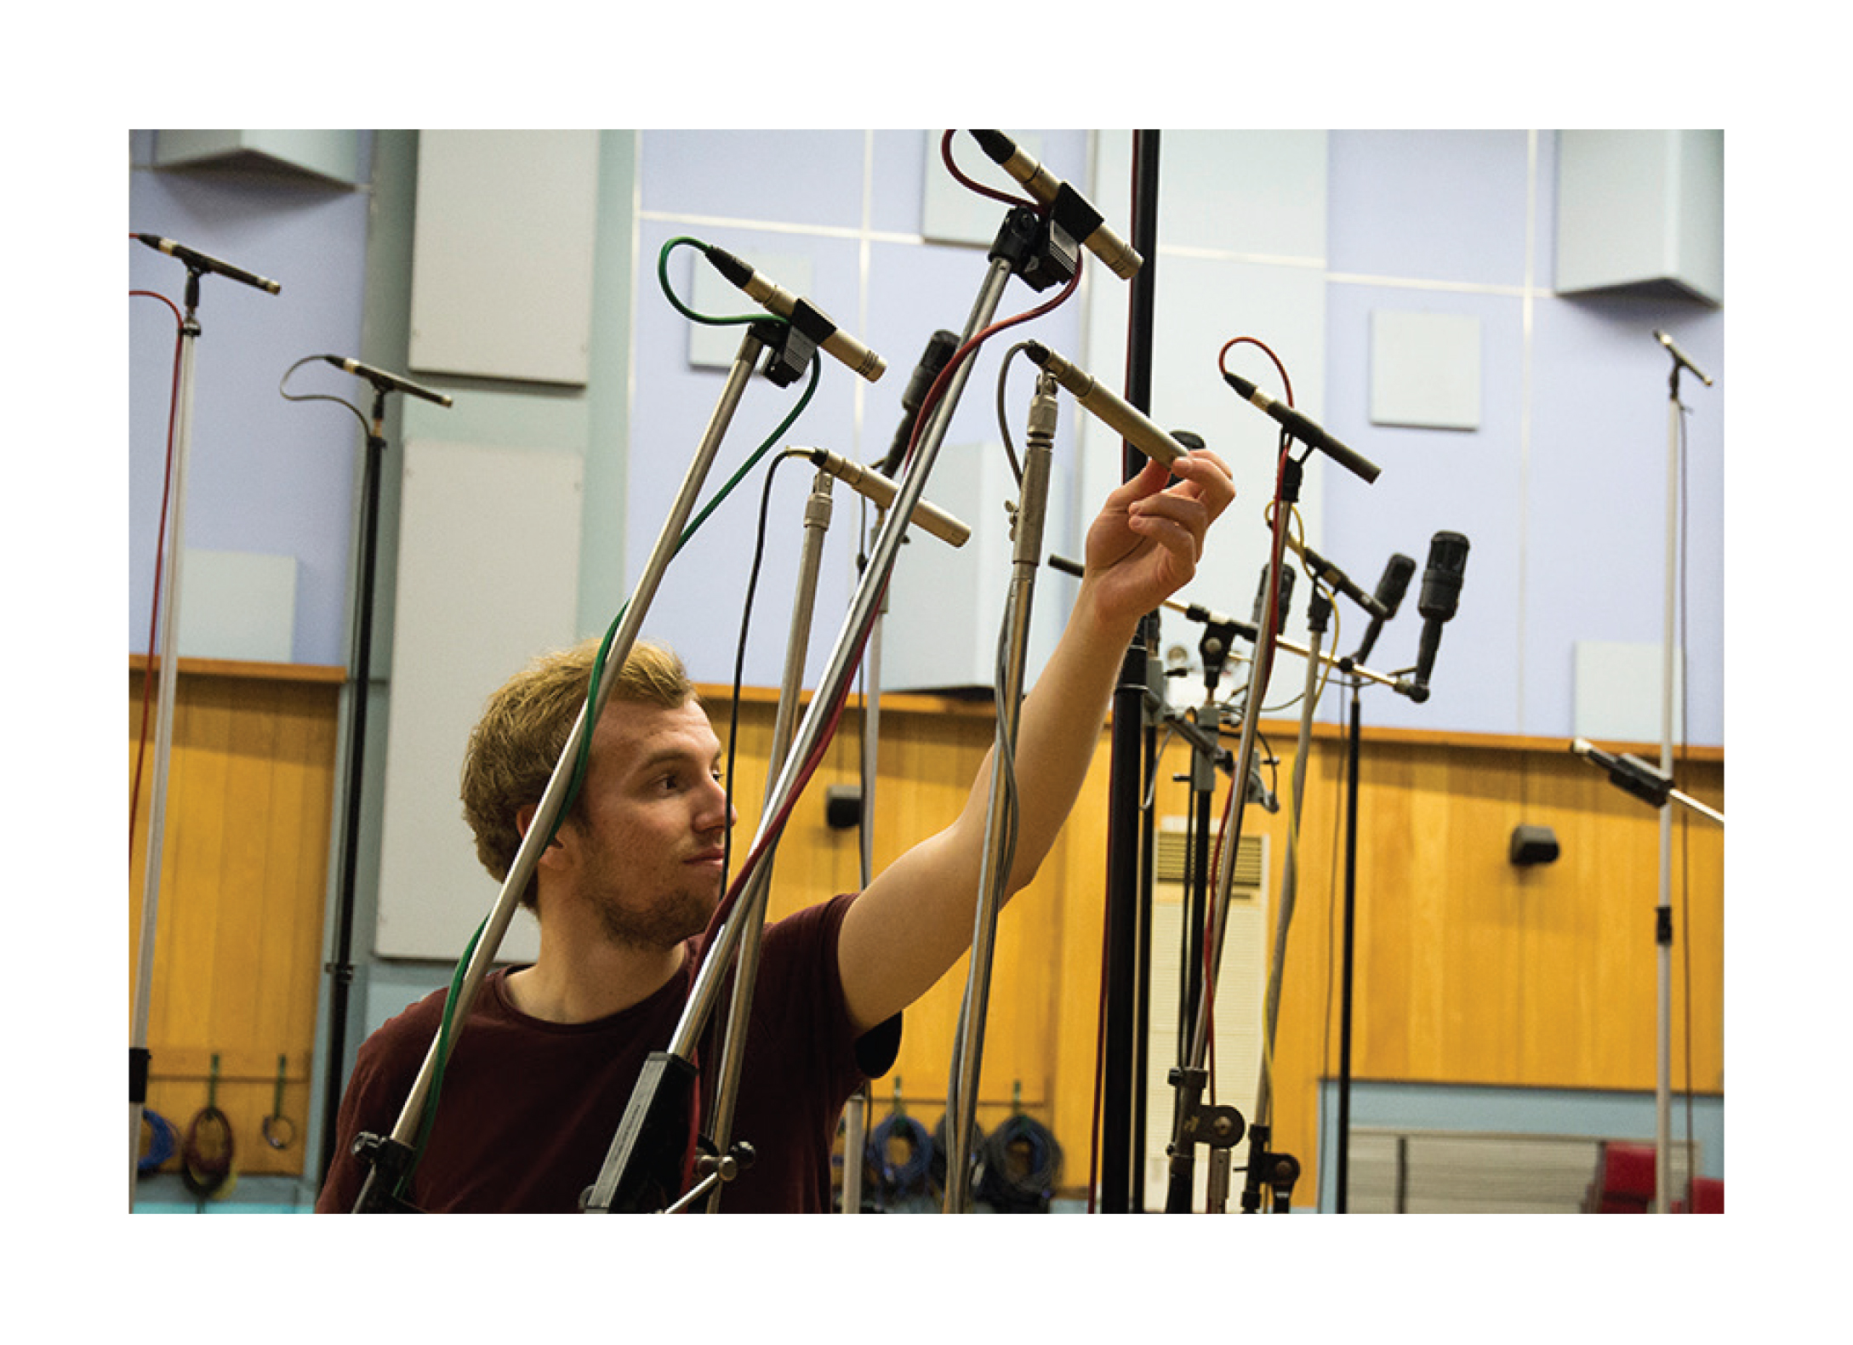
RECORDING PROCESS
The sound of the CFX Concert Grand piano was captured by a team of highly experienced Abbey Road Studios recording engineers, each contributing decades of knowledge in recording pianos for a variety of applications.
Microphone set-ups, also referred to as perspectives, have a huge effect on the overall sound of the recorded instrument. Each set of perspectives speaks specifically to various musical settings.
These set-ups have been and are continually used by the finest recording artists in the world and have been presented here for use as a sampled instrument for the first time ever.

Slide 10
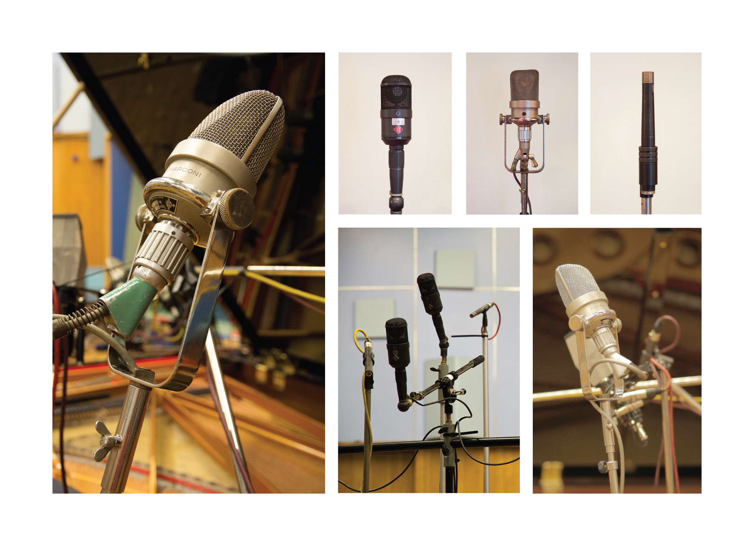
CLASSIC Microphone Perspective
The Classic perspective most faithfully captures the natural tonal character, clarity and nuance of the instrument.

Slide 11
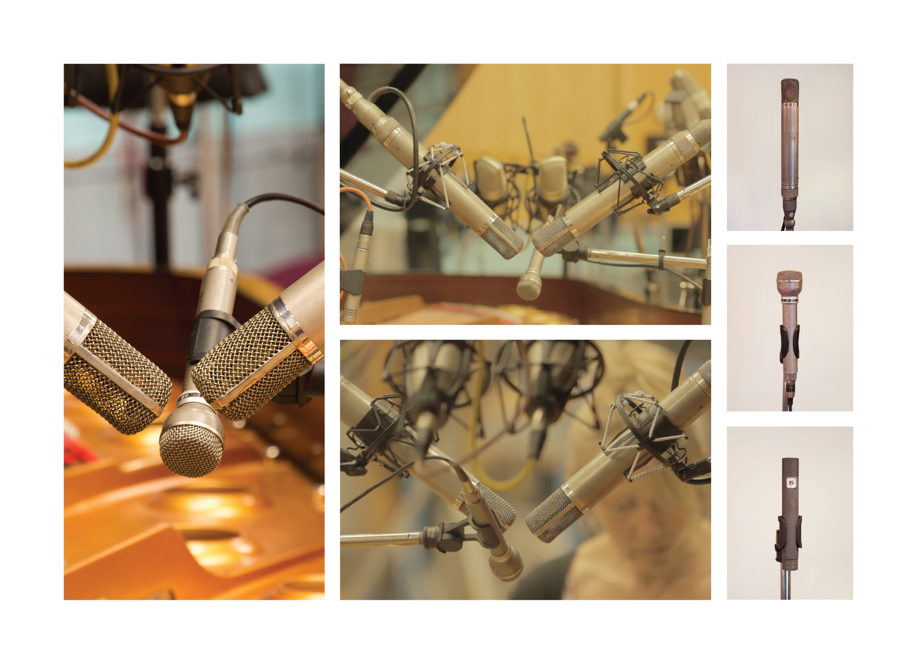
CONTEMPORARY Microphone Perspective
The Contemporary perspective creates a piano sound that is bright and hard with lots of attack from the hammers, but also maintains the piano’s warmth with intimate ambience.

Slide 12
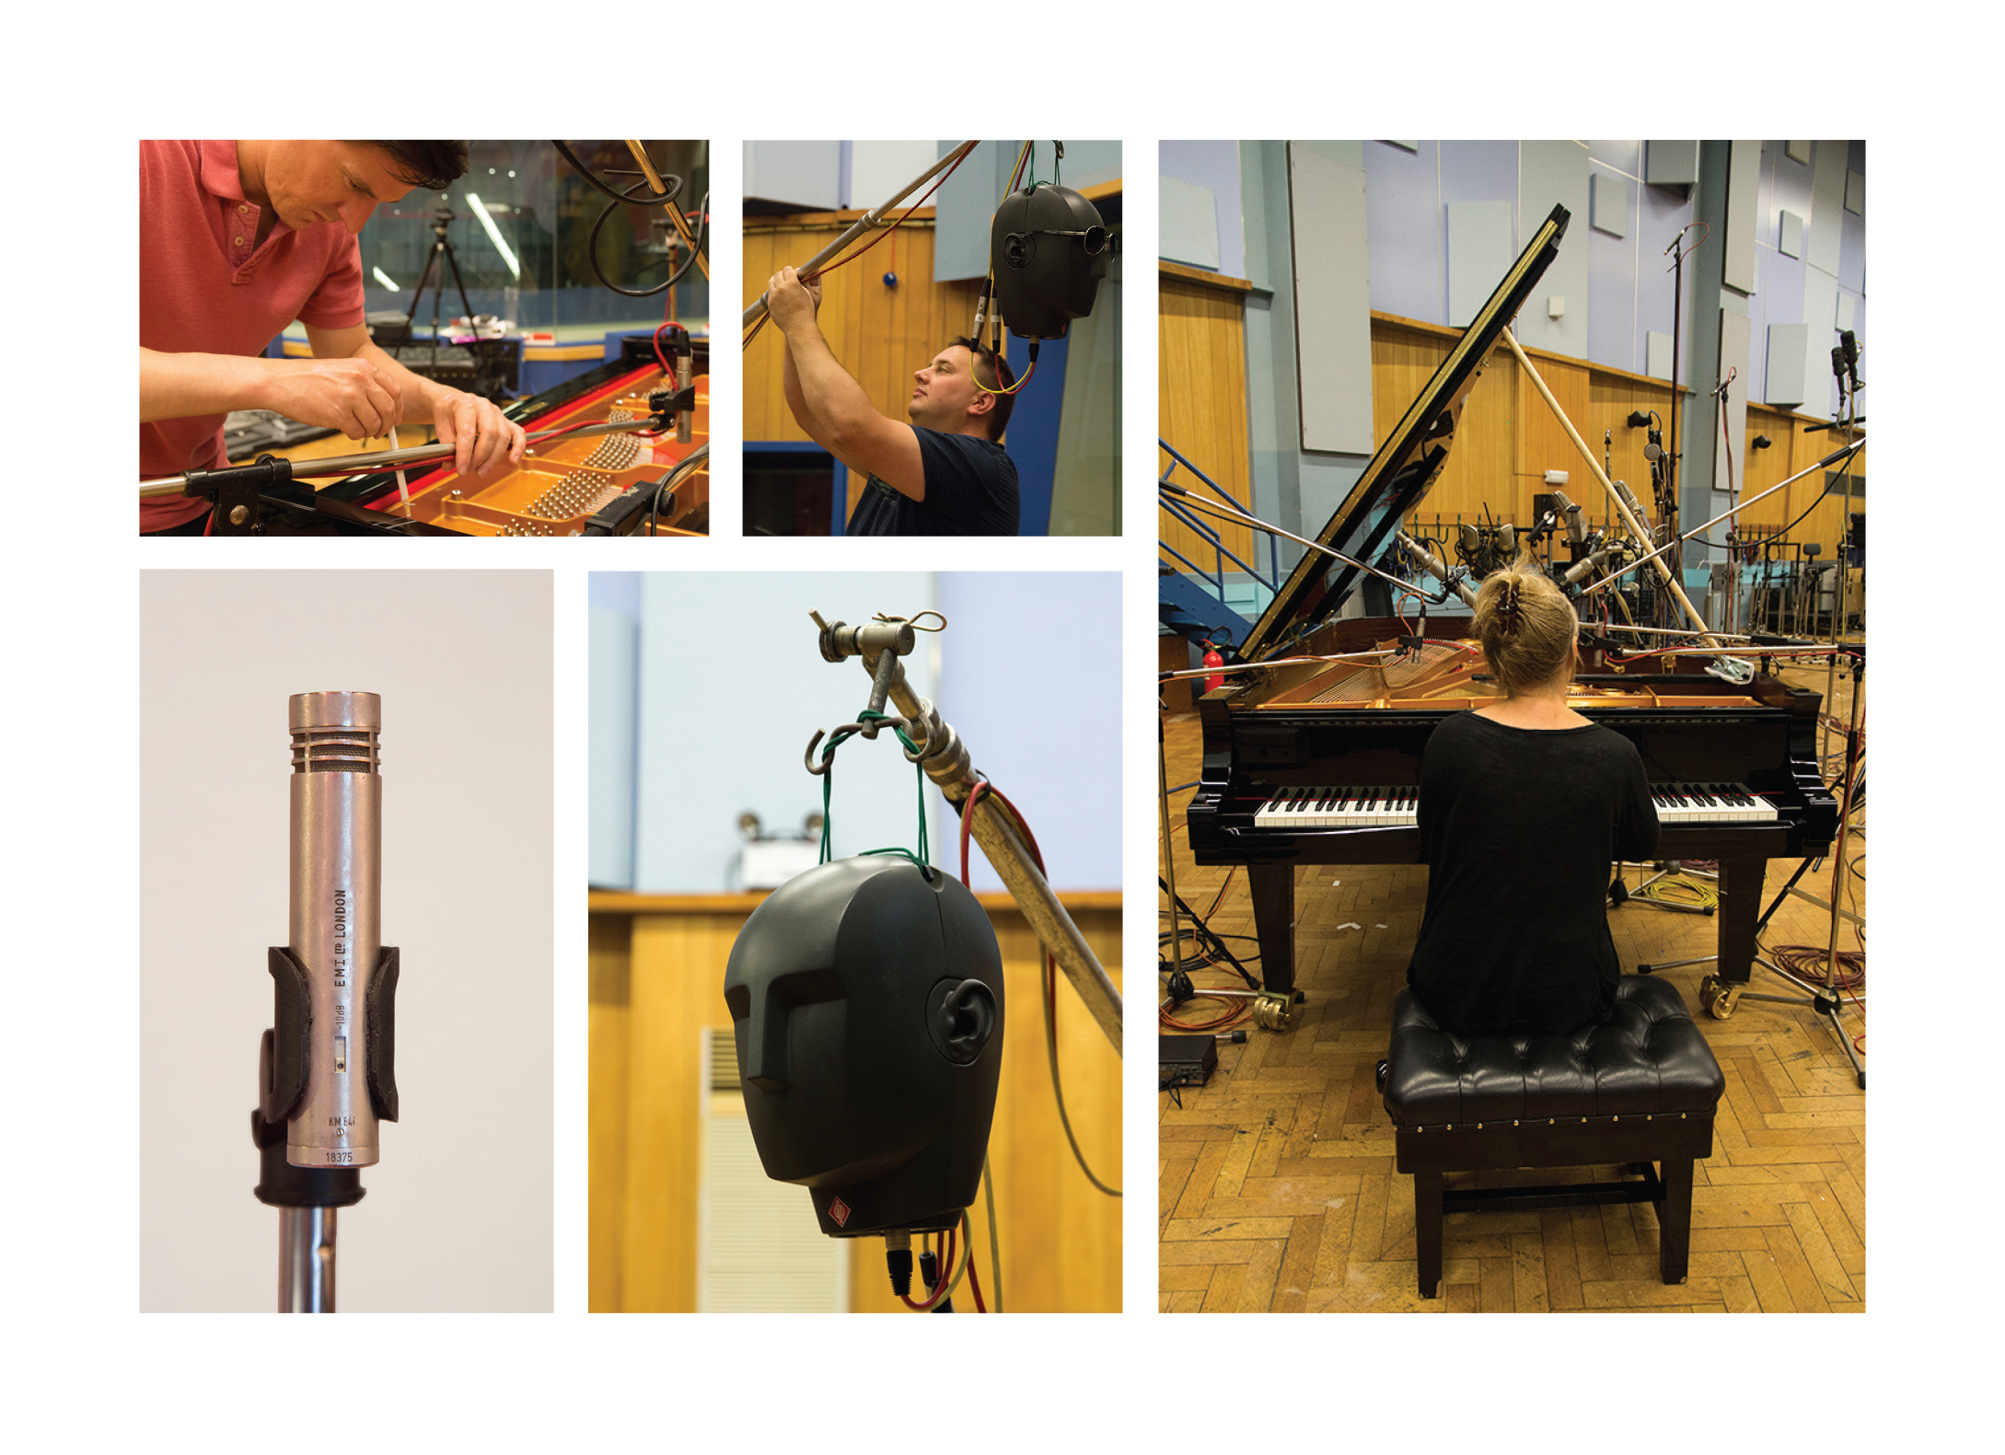
PLAYER Microphone Perspective
The Player perspective offers the experience of playing the CFX from the piano bench in Studio One, particularly when reproduced over high quality headphones.

Slide 13
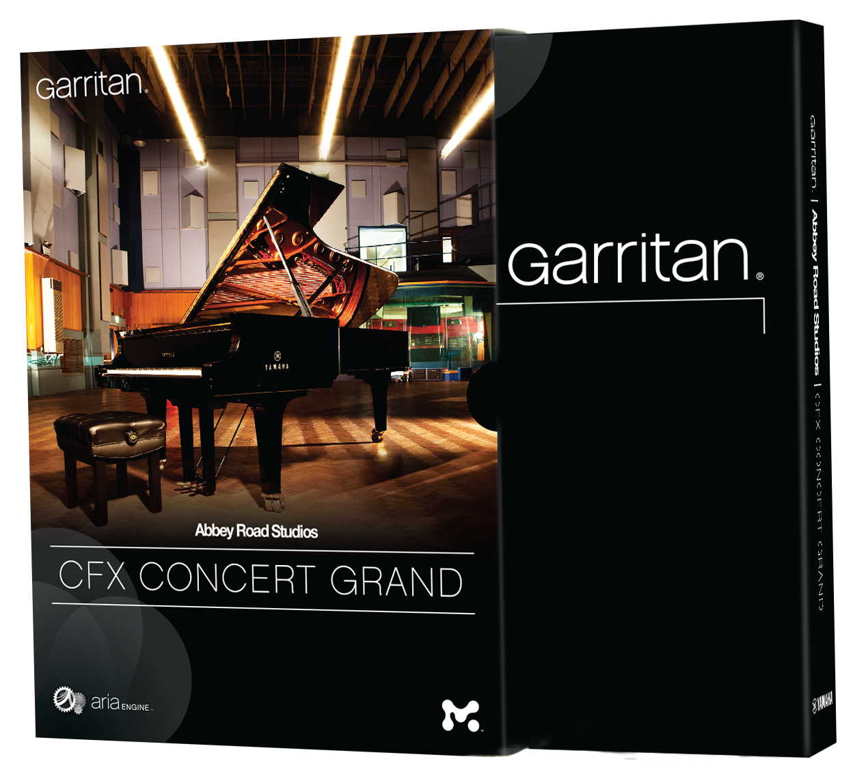
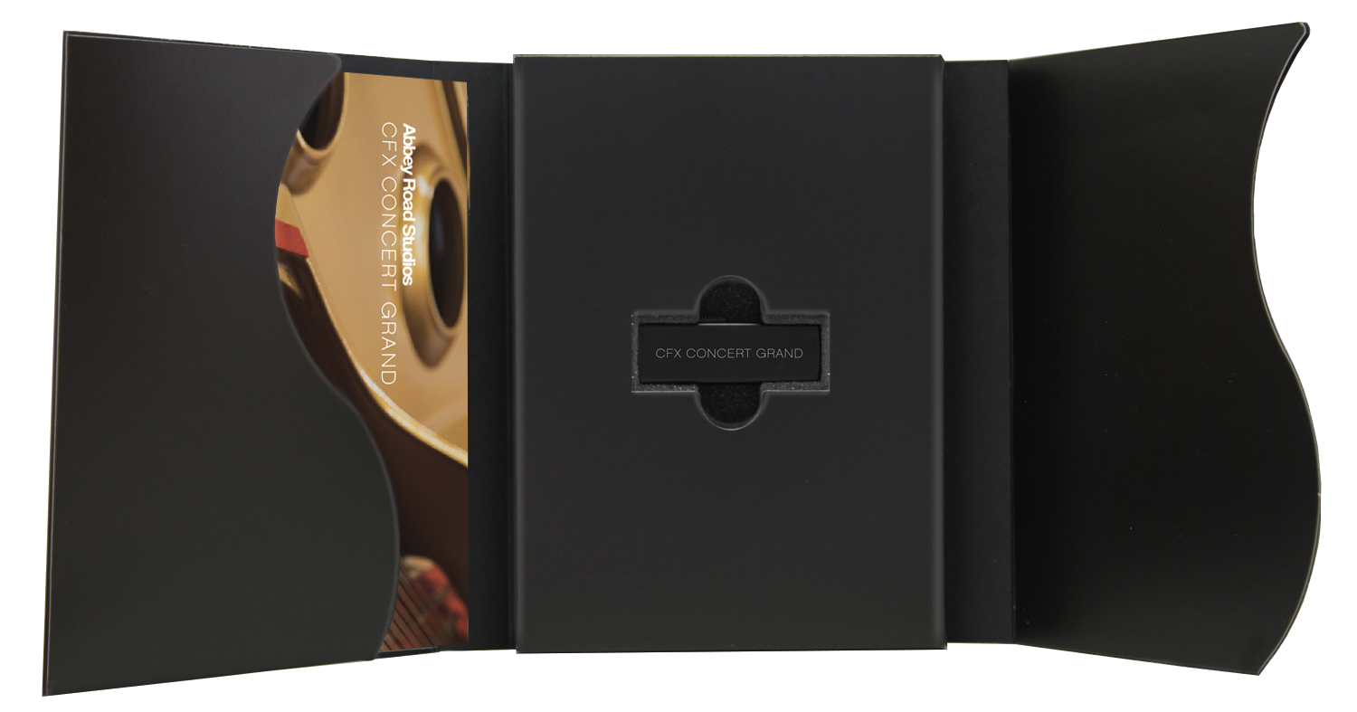
THE PRODUCT
Garritan Sound libraries enhance the playback of any DAW or
any notation program such as Finale
Media 32GB Flash Drive
SRP $299.95
Compatibility DAWs:
ProTools, Logic, Sonar, Cubase
GarageBand, Ableton
Notation:
Sibelius, Seamless integration into Finale

Slide 14
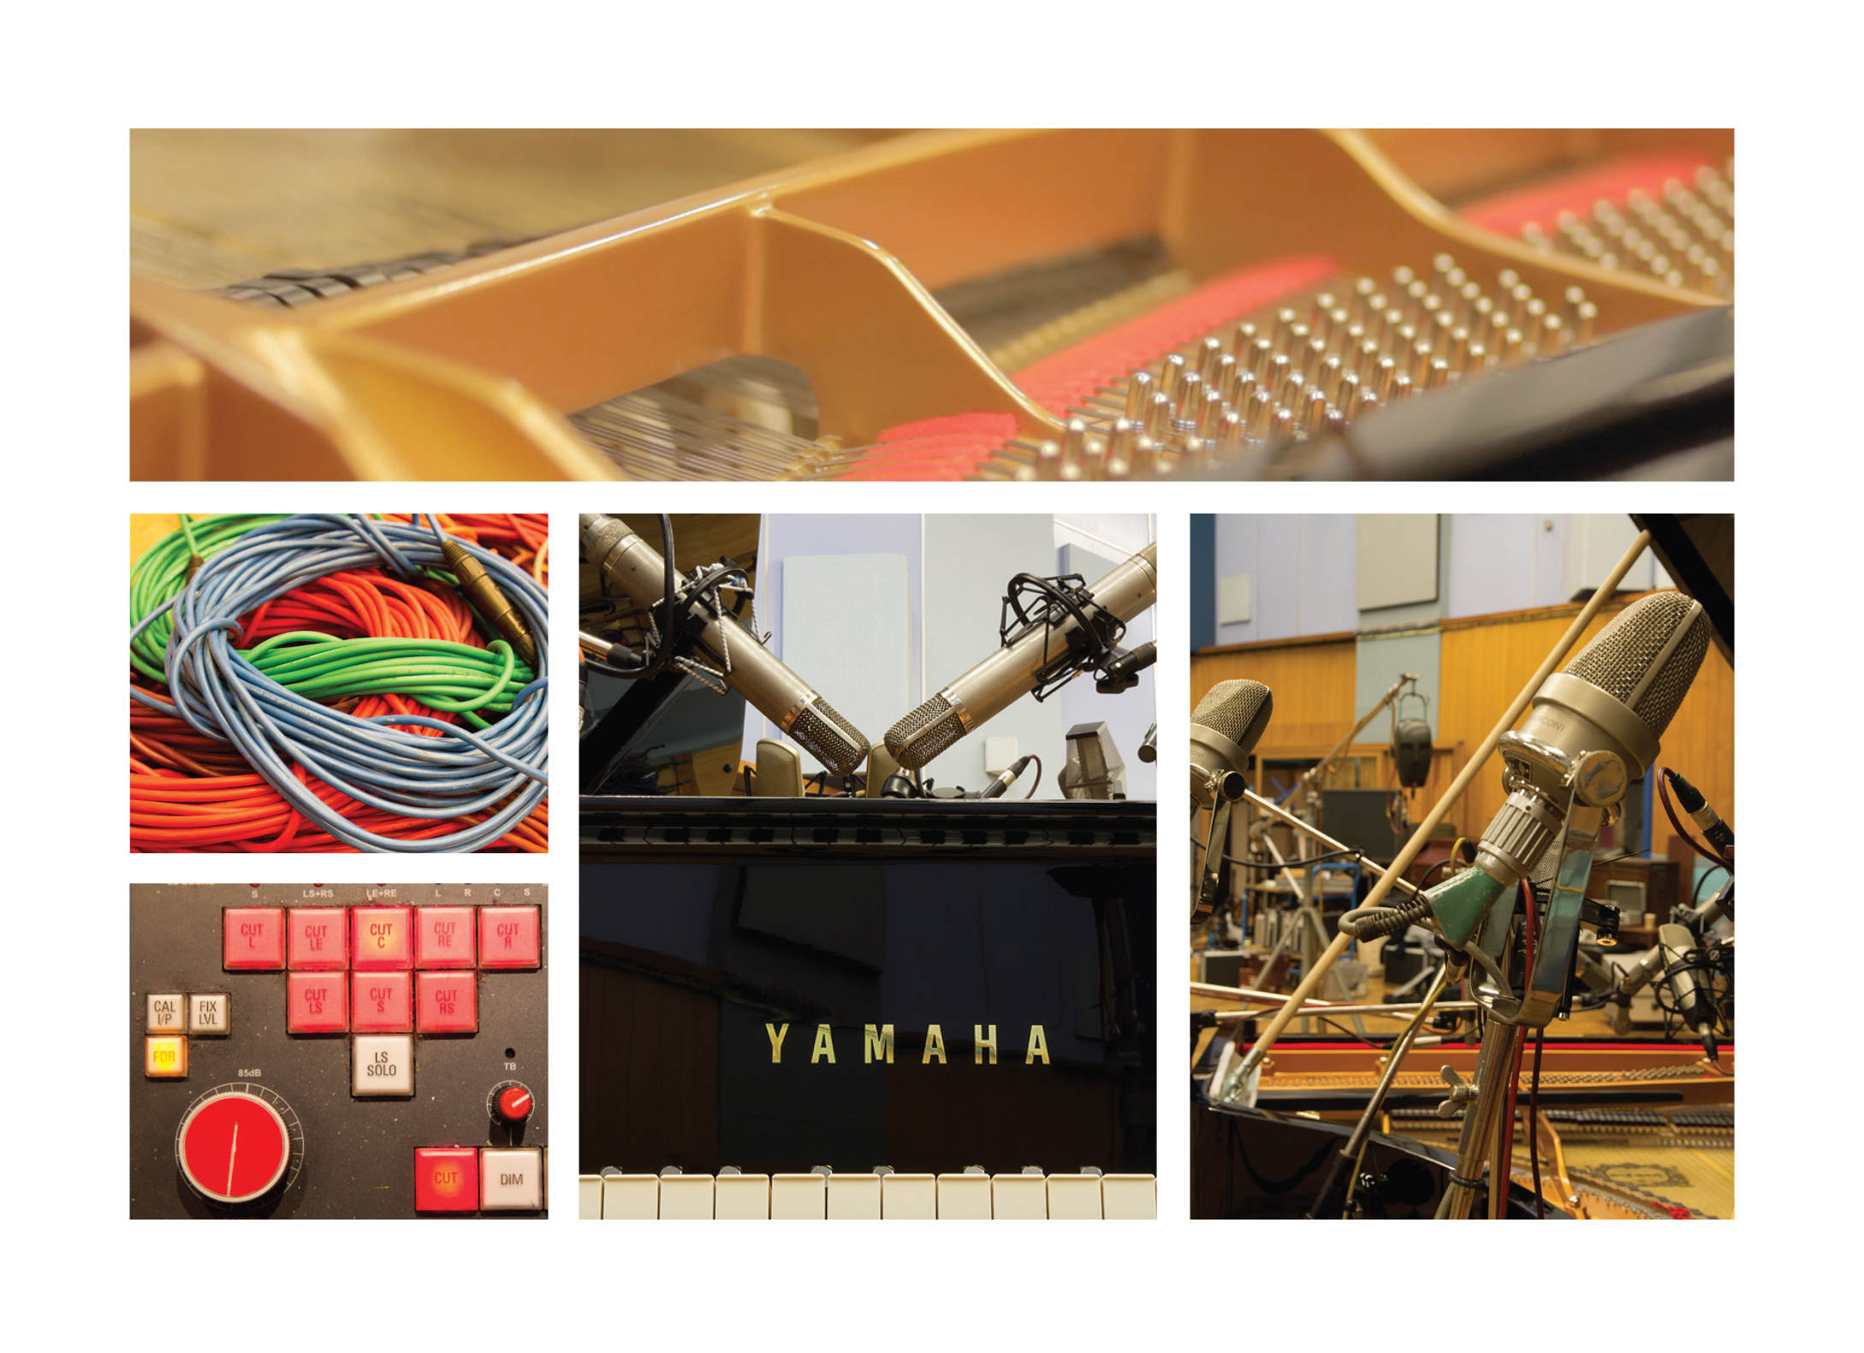
The Instrument The Room The Microphones The Engineers
The Garritan Abbey Road Studios CFX Concert Grand library faithfully reproduces this stunning piano as recorded in Abbey Road Studios’ legendary Studio One.
It simply does not get better than that.
Play today and experience a piano with power, richness and clarity that is unmatched.
Hear it here...

Slide 15
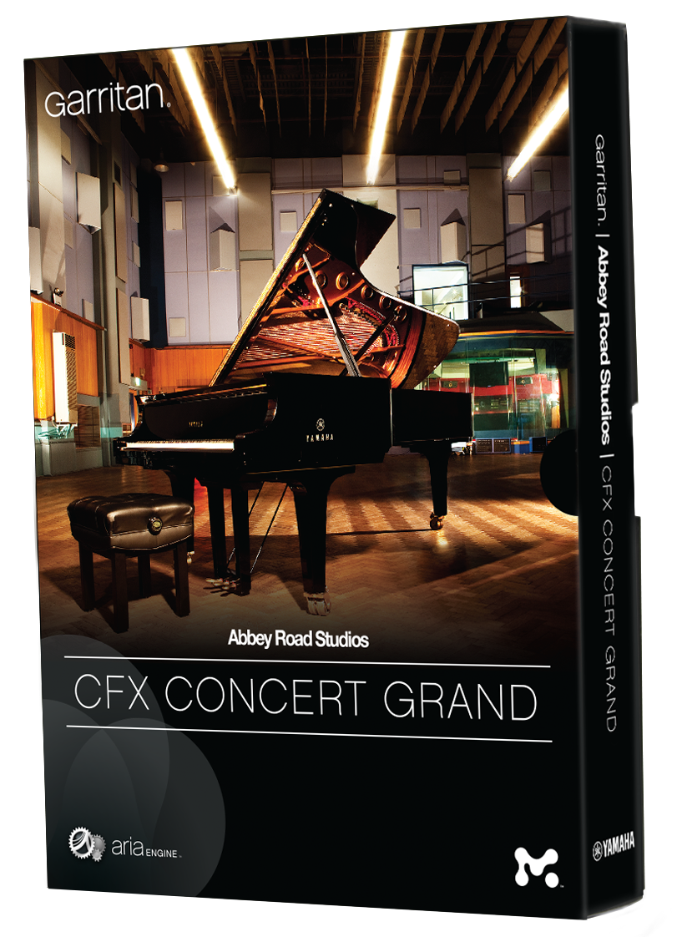
Passion reflected in every detail

